Slide 1

Design and Analysis of Algorithm
Tanveer Ahmed Siddiqui

Slide 2

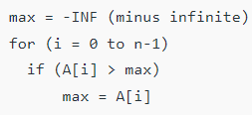
Example 1:
Find maximum element max in the array.
Loop invariant: max is always maximum among the first i elements of array A.

Slide 3
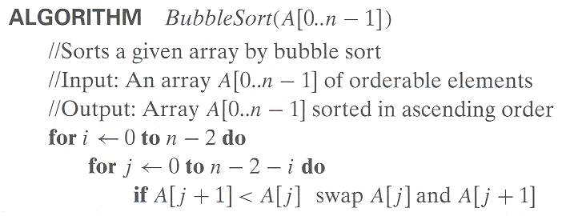
Example 1: Bubble Sort
Basic idea (lighter bubbles rise to the top):
  Exchange neighbouring items until the largest item reaches the end of the array
  Repeat for the rest of the array

Slide 4
Example 1: Bubble Sort
a:
19
5
12
7
a:
a:
5
12
7
19
0
1
2
3
0
1
2
3
a:
5
19
12
7
a:
5
7
12
19
0
1
2
3
0
1
2
3
a:
5
12
19
7
a:
5
7
12
19
0
1
2
3
0
1
2
3
a:
5
12
7
19
a:
5
7
12
19
0
1
2
3
0
1
2
3
a:
5
7
12
19
a:
5
12
7
19
0
1
2
3
0
1
2
3

Slide 5
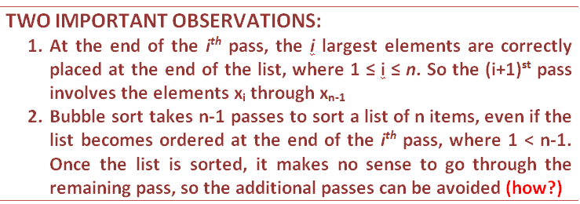
Example 1: Bubble Sort

Slide 6
Example 1: Bubble Sort
Pre- Condition: The input variable A[1], A[2], . . . A[n] is a one-dimensional array of real numbers.
Post- Condition: The input variable B[1], B[2], . . . B[n] is a one-dimensional array of real numbers with same elements as A[1], A[2], . . . A[n] but with the property that B[i] ≤B[j] whenever i ≤ j.
Loop Invariant: Let P(n) = The algorithm sorts every list of size n ≥ 1

Slide 7
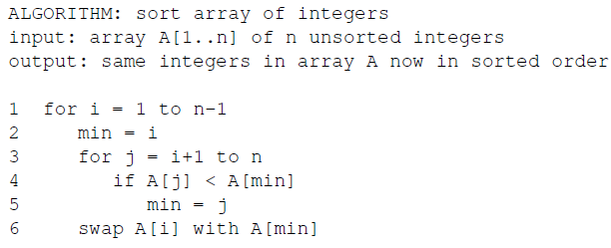
Brute Force: Selection Sort
Example 2: Selection Sort
| 89 45 68 90 29 34 17
17 | 45 68 90 29 34 89
17 29 | 68 90 45 34 89
17 29 34 45 | 90 68 89
17 29 34 45 68 | 90 89
17 29 34 45 68 89 | 90
In selection sort algorithm we find the minimum element from the unsorted part and put it at the beginning.

Slide 8
Brute Force: Selection Sort
Example 2: Selection Sort
| 89 45 68 90 29 34 17
17 | 45 68 90 29 34 89
In the above pseudo code there are two loop invariant condition:
In the outer loop, array is sorted for first i elements.
In the inner loop, min is always the minimum value in A[i … j].
17 29 | 68 90 45 34 89
17 29 34 45 | 90 68 89
17 29 34 45 68 | 90 89
17 29 34 45 68 89 | 90
Loop Invariant: Before the start of each loop, A[min] is less than or equal to A[i..j-1].
Note that we use the notation i..j to denote the set {x | i ≤ x ≤ j} = {i,i+1,...,j-1,j}.
We use the notation a[i..j] to indicate the subsequence of the array a starting from a[i] and continuing up to and including a[j].

Slide 9
Brute Force: Selection Sort
Example 2: Selection Sort
| 89 45 68 90 29 34 17
17 | 45 68 90 29 34 89
In the above pseudo code there are two loop invariant condition:
In the outer loop, array is sorted for first i elements.
In the inner loop, min is always the minimum value in A[i to j].
17 29 | 68 90 45 34 89
17 29 34 45 | 90 68 89
17 29 34 45 68 | 90 89
17 29 34 45 68 89 | 90
Loop Invariant: Before the start of each loop, A[min] is less than or equal to A[i..j-1].

Slide 10
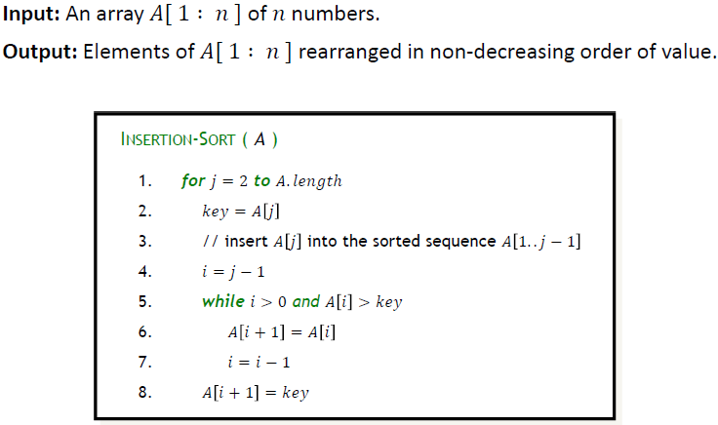
Example 7: Insertion Sort algorithm

Slide 11
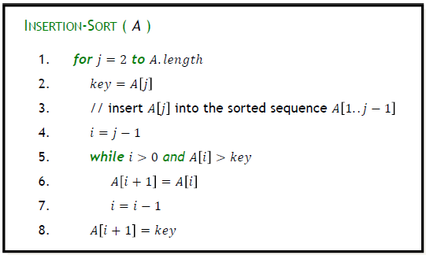
Insertion Sort:
89 | 45 68 90 29 34 17
45 89 | 68 90 29 34 17
45 68 89 | 90 29 34 17
45 68 89 90 | 29 34 17
29 45 68 89 90 | 34 17
29 34 45 68 89 90 | 17
17 29 34 45 68 89 90

Slide 12
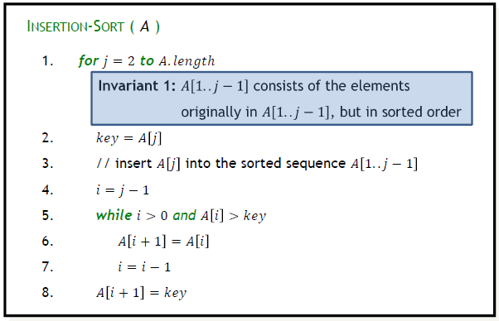
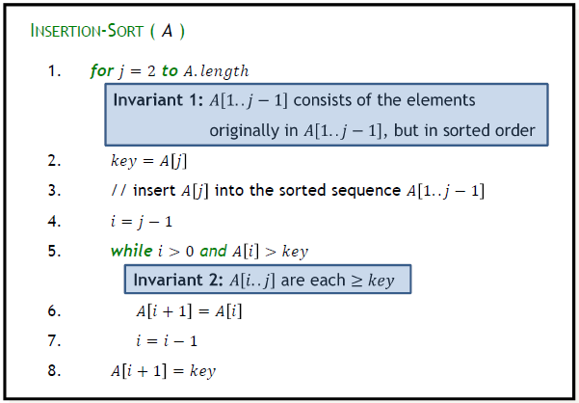
Insertion Sort:
89 | 45 68 90 29 34 17
45 89 | 68 90 29 34 17
45 68 89 | 90 29 34 17
45 68 89 90 | 29 34 17
29 45 68 89 90 | 34 17
29 34 45 68 89 90 | 17
17 29 34 45 68 89 90

Slide 13
Insertion Sort:
89 | 45 68 90 29 34 17
45 89 | 68 90 29 34 17
45 68 89 | 90 29 34 17
45 68 89 90 | 29 34 17
29 45 68 89 90 | 34 17
29 34 45 68 89 90 | 17
17 29 34 45 68 89 90
Invariant: at the start of each for loop, A[1…j-1] consists of elements originally in A[1…j-1] but in sorted order

